Slide 1
SPEED DATING: What predicts a match?
Miranda Remmer
DS-GA-23 Final Project

Slide 2
BACKGROUND
What makes a good first impression ?
What influences dating decisions?
How does gender influence selection?
How do perceptions play into choices?

Slide 3
THE DATA SET
Data pulled from a experimental speed dating event, from 2002-2004, sheds insight into dating decisions and outcomes, particularly with first impressions.
Participants were asked a series of questions throughout the experiment; (roughly) 1/3 in the signup survey, 1/3 during the experiment, and 1/3 at the conclusion of the experiment. To standardized observations, six attributes were used throughout: attractiveness, sincerity, intelligence, fun, ambition, and shared interests.
Scores assigned to each attribute at different points in the experiment can be used to predict matches.

Slide 4
THE PROBLEM
Can one’s perception of self predict his/her dating outcome?
Does this differ by gender?

Slide 5
THE HYPOTHESIS
Individuals with lower self-esteem (i.e. give themselves lower scores during self-evaluation), receive fewer dates (i.e. matches) than those who provide more positive ratings.

Slide 6
THE DATA BREAKDOWN
195 features
8378 observations
a few features -
IID#
Gender (F=0 | M=1)
Dec: decision (yes = 1 | no = 0)
Dec_o: decision of partner at event (yes = 1 | no = 0)
Match: partner and subject both said ‘yes’ = 1
Met_Count: number of people subject met with
Match_es: number of matches a participant expects

Slide 7
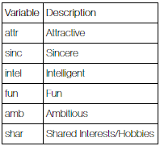
THE DATA BREAKDOWN cont.
Aside from demographic questions (e.g. age, religion) or questions that are only asked once (e.g. match_es); each survey question that uses the 6 attributes, are coded with numbers to indicate when during the survey they are administered.
Example:
A. How do you think others perceive you? (signup survey)
Rate each attribute on a scale of 1-10
attr3_1
sinc3_1
intel3_1
fun3_1
amb3_1
B. How do you think others perceive you? (after experiment)
Rate each attribute on a scale of 1-10
attr3_2
sinc3_2
intel3_2
fun3_2
amb3_2
Notes:
Aside from questions that are only asked once (gender, age, occupation, exphappy (i.e. how happy do you expect to be with the people you meet)…etc.…Features are coded with numbers to indicate when during the survey they are administered

Slide 8
THE DATA BREAKDOWN cont.
C. What do you think the opposite sex looks for in a date? (signup survey)
Rate each attribute on a scale of 1-10
attr2_1
sinc2_1
intel2_1
fun2_1
amb2_1
D. Based on what you think the opposite sex looks for in a data, how do you measure up? (signup survey)
Rate each attribute on a scale of 1-10
attr3_1
sinc3_1
intel3_1
fun3_1
amb3_1
Notes:
Aside from questions that are only asked once (gender, age, occupation, exphappy (i.e. how happy do you expect to be with the people you meet)…etc.…Features are coded with numbers to indicate when during the survey they are administered

Slide 9
THE DATA BREAKDOWN cont.
Scorecards are also administered to each participant asking him/her to rate the partners he/she meets with (filled out after each ‘date’):
Rate their attributes on a scale of 1-10: (1=awful, 10=great)
Attractive
Sincere
Intelligent
Fun
Ambitious
Shared Interests/Hobbies
Decision: yes/no
Like: overall how much do you like this person (1=don't like at all, 10=like a lot)
Prob: how probable do you think it is that this person will say ‘yes’ to you? (1=not probable, 10=extremely probable)
Partner’s rating of subject also coded as a feature: attr_o, sinc_o, intel_o, prob_o….etc.
Notes:
Aside from questions that are only asked once (gender, age, occupation, exphappy (i.e. how happy do you expect to be with the people you meet)…etc.…Features are coded with numbers to indicate when during the survey they are administered

Slide 10
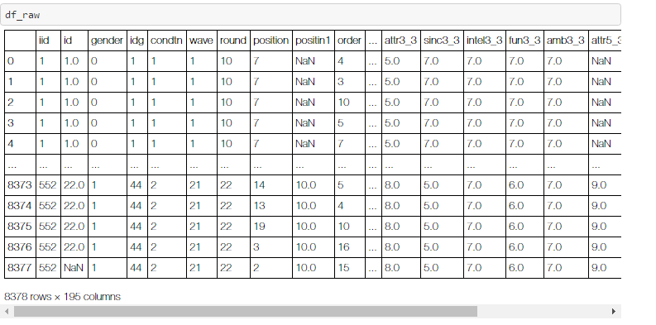
THE PROCESS
Selecting which questions pertain to research question
Some questions are scaled at 100pts across all attributes; others at 10pts per attribute
View & Clean the data
Logistic regression: classification (match vs. no match)
IID#s – what to do...
Notes:
deciphering every feature b/c all were labeled the same just with a different reference # at the end to indicate when in the survey / experiment the question had been administered and/or who (subject or partner)
Had to sort though every feature to figure out which would be relevant to my question → issue there was I couldn’t figure out the approach I wanted to take on my question so instead of making up my mind, I decided to try and keep all the day (bad idea)
Started w/ logistic regression viewing the research question as a classification problem (match vs. no match)
However; came across the issue with IIDs
Each persons’ unique subject number
Some columns had the same data all the way down per iid #; other questions, like scorecards, had different numbers in each feature per iid

Slide 11
THE PROCESS cont.
Re-Selecting questions pertaining to research question
Get all attributes scaled 1-10pts
CLEAN THE DATA ☺
Drop columns with incomplete data
NaN values? Two options..
Remove NaN values
Replace NaN values with ‘0’
*Create functions*
Notes:
Started the process of cleaning my data over
Like was predicted in the beginning of class.. We will spend most of our time cleaning our data… Smiley face is slightly sarcastic..
Created functions in a spate notebook, imported as module

Slide 12
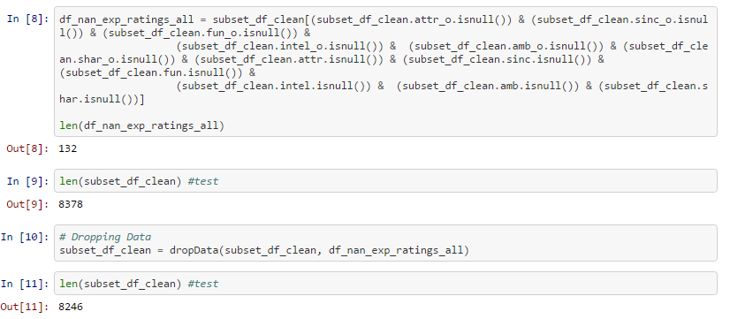
Example of dropping data: participant and partner didn’t score – most likely didn’t participate

Slide 13
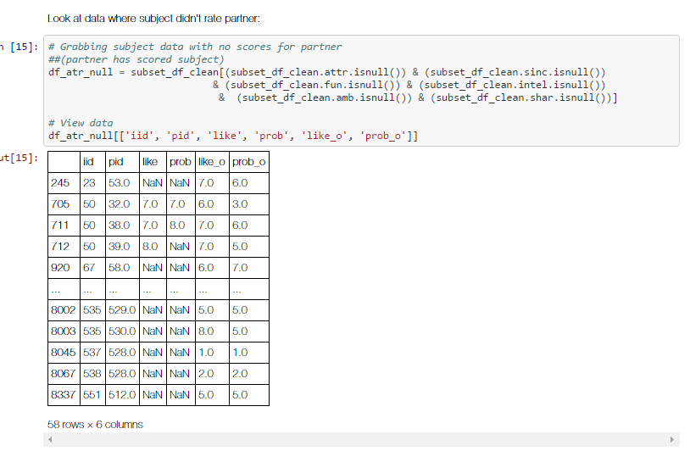
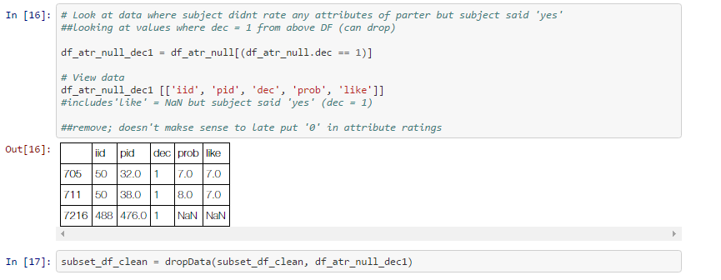
Example of dropping data: participant didn’t score partner but said ‘yes’
Notes:
Created functions to drop data
Did the same with with attr_o

Slide 14
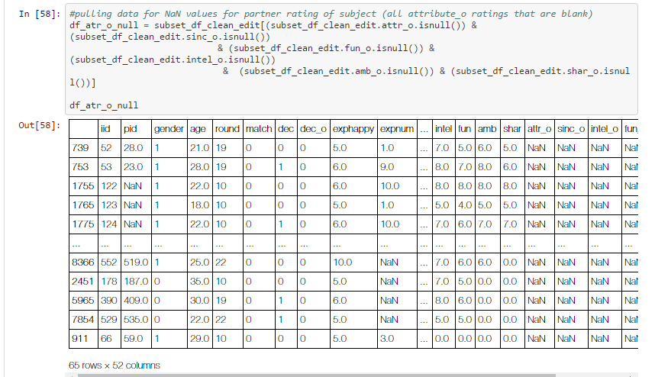
Example of adding 0 for NaN values : participant scored for at least 1 of the other attributes but left others blank (esp. if dec=0)
Look where all values for attribute_ratings_other are null (aka partner’s ratings)
Notes:
Went through and tested (a lot) that my values were correctly changing or dropping

Slide 15
Created a function to drop the index of where all the feature info is blank; use this to fill other attribute ratings with null values as ‘o’
def cleanDF(main_df, df_all_feature_null, feature):
atr_nan = main_df[main_df[feature].isnull()] #look where partner did not rate subject on feature
atr_cleaned = atr_nan.drop(df_all_feature_null.index) #returning just rows with NaN data in feature but have other columns with data within feature set
fillNaN([feature], atr_cleaned) ##calling function fillNaN to replace NaN values with 0
main_df = main_df.drop(atr_cleaned.index) #removing old values
main_df = pd.concat([main_df, atr_cleaned]) #adding cleaned data back into df
return main_df
Notes:
Went through and tested (a lot) that my values were correctly changing or dropping

Slide 16
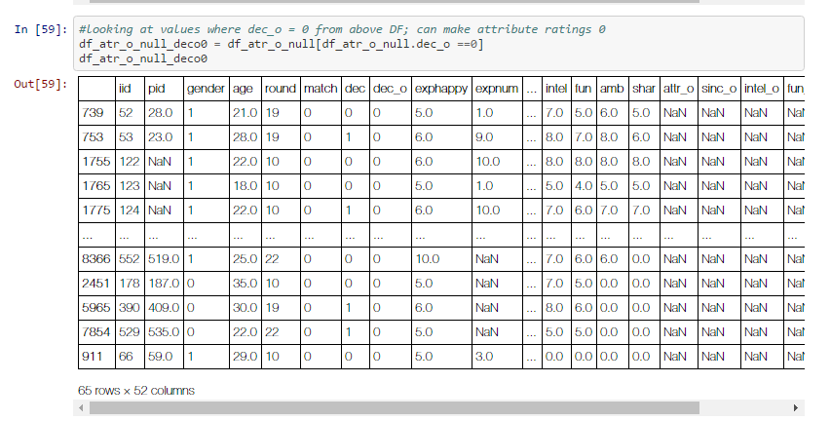
Look where all values from the null_all_df where dec_o =0

Slide 17
Within this DF, look at where like_o has no value; added a ‘0’ to NaN values
(no ratings for partner, decision = no, like _o = NaN)
Notes:
No ratings for partner, dec=NO; like = NaN; I made it 0

Slide 18
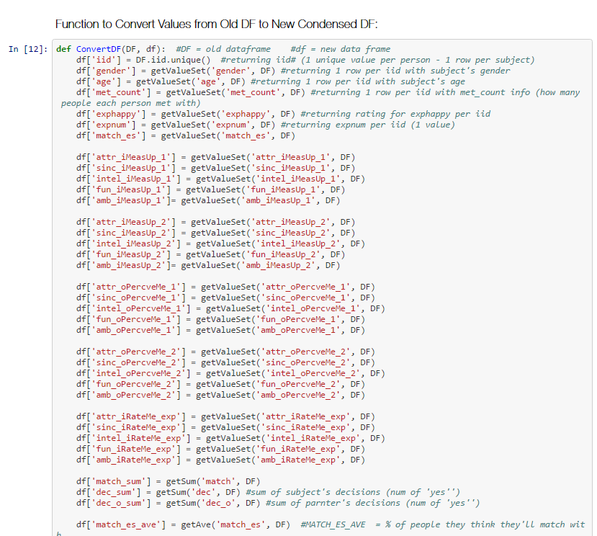
Recount met_count
Rename features
Separate between male and female datasets
Condense the data (combine iids)
dec_sum: sum of subject's decisions (# of 'yes')
dec_o_sum: sum of partner's decisions (# of 'yes')
attr_ave: average ‘attractive’ rating subject gave partners he/she met with (sum of ‘attractive’ ratings/met_count)
attr_o_ave: average attractive rating partners gave subject
Notes:
Re-count met: if data was dropped b/c data wasn’t valuable; i.e. didn’t rate partner at all and/or partner didn’t rate them
Did a lot of averages; probably more than I should; but I thought it would be interesting for data exploration
(see how many matches someone got out of the # of people he/she met with) b/c every ‘grouping’ et with a different # of people

Slide 19
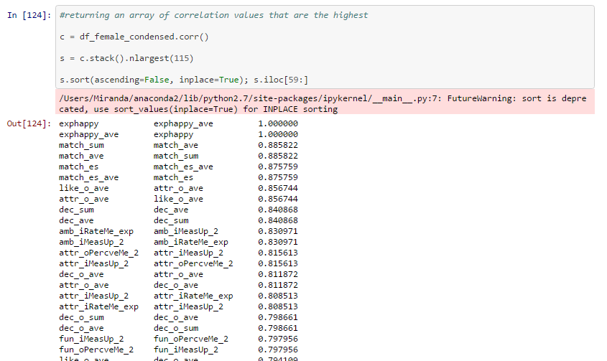
DATA EXPLORATION & ANALYSIS
Correlations on female DF:
like_o_ave | attr_o_ave : 0.856744
dec_o_ave | attr_o_ave : 0.811872
like_o_ave | fun_o_ave : 0.779505
like_ave | attr_ave : 0.730203
like_ave | fun_ave : 0.727753
dec_match_ave | attr_o_ave : 0.620261
match_sum correlations
match_ave |  | 0.885822
dec_sum |  | 0.600592
dec_match_ave |  | 0.58332
dec_o_sum |  | 0.558067
dec_ave |  | 0.486358
match_es |  | 0.459059
dec_o_ave |  | 0.434573
like_o_ave |  | 0.389363
attr_o_ave |  | 0.379035
fun_o_ave |  | 0.350454
match_es_ave |  | 0.315399
Notes:
DEC_O AND ATTR_O – for men :
men who rated women as more attractive said 'yes' to a higher # of women out of the total they met with
(same thing for like_o and attr_o)
Dec_match_ave & attrc_o ave: the more attractive a female is, the more correlated its to her average of dec=yes to people she matched with

Slide 20
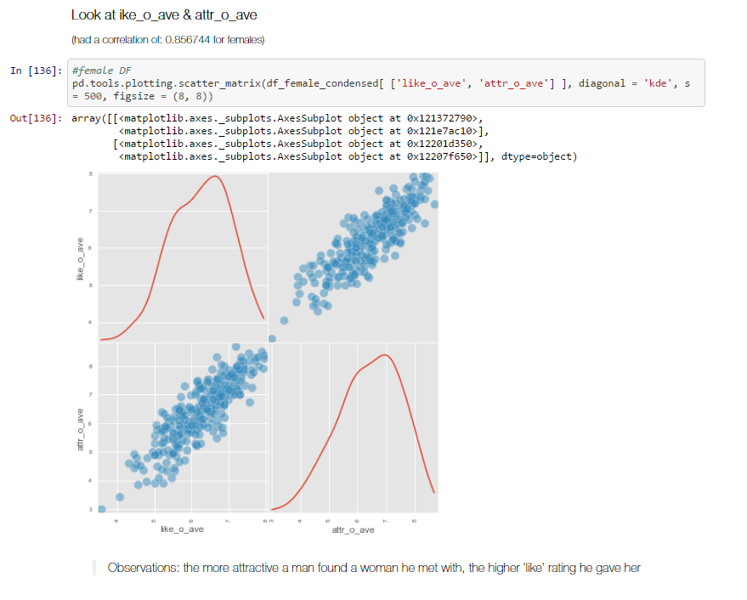
like_o & attr_o_ave

Slide 21
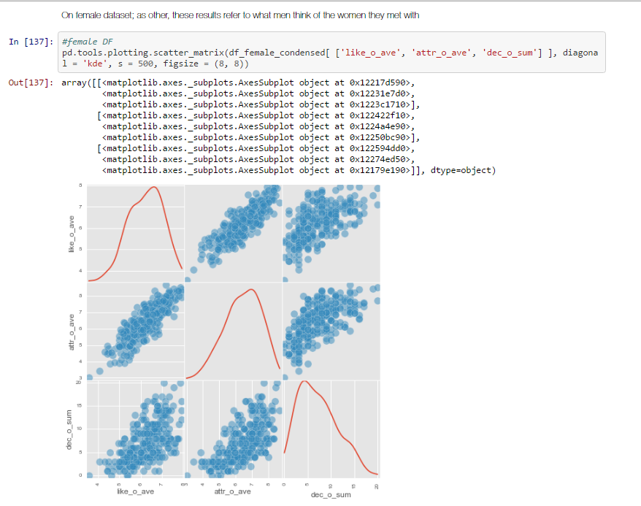
like_o & attr_o_ave & dec_o_sum

Slide 22
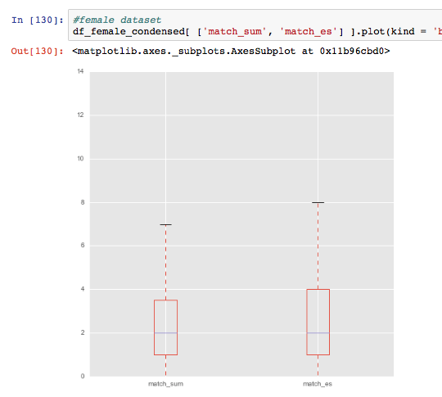
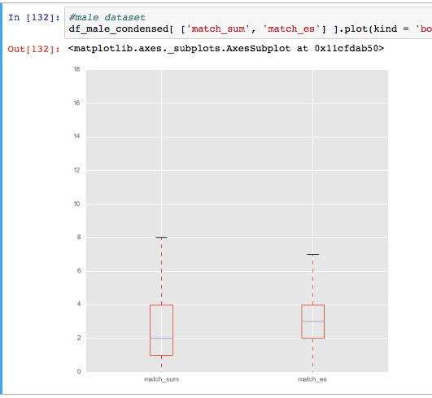
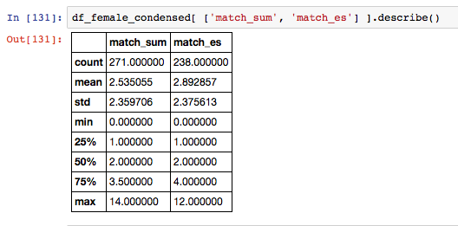
View data match_sum vs. match_es
FEMALES
MALES
Notes:
Observations: on average, males overshot the # of matches they beleive they got; women were more accurate

Slide 23
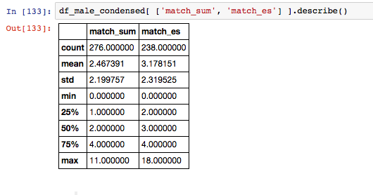
View data match_sum vs. match_es
FEMALES
MALES
Notes:
Observations: on average, males overshot the # of matches they beleive they got; women were more accurate

Slide 24
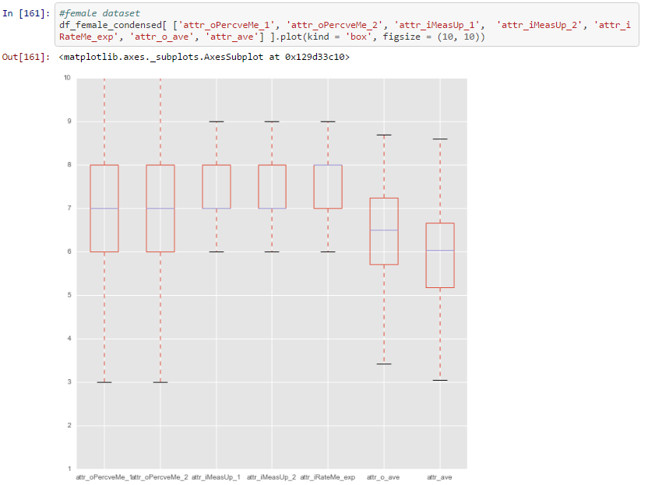
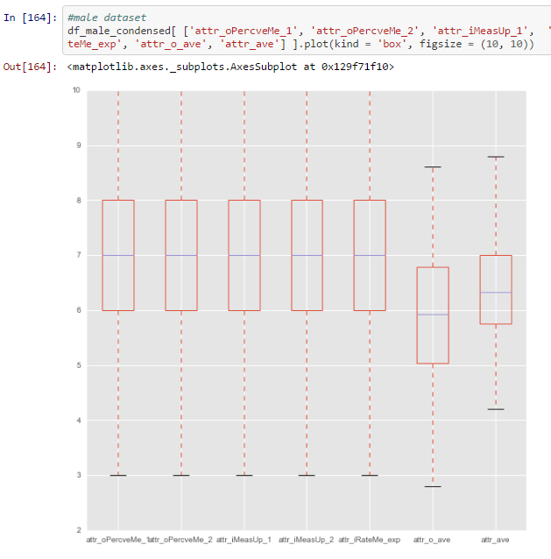
View data for all self-ratings of ‘attractiveness’ as well as ratings by partners
FEMALES
MALES
Notes:
Q before and after experiment; as well as during
females:: Observations: mean is the same but the descrepency in scores is larger; 25% of the scores women give themselves whehn seeing how others perceive themselves is lower than when they rate their attractiveness compared to what they think men want
women view themselves as more attractive than men see them as; women view men as less attractive on average than women
Men: Observations: males on the other hand are much more consistant when rating their level of 'attractivness‘
men are extremely consistant when it comes to rating their level of 'attractivness'. men also view women as less attractive on average; and women view them as less attractive than they see themselves as

Slide 25
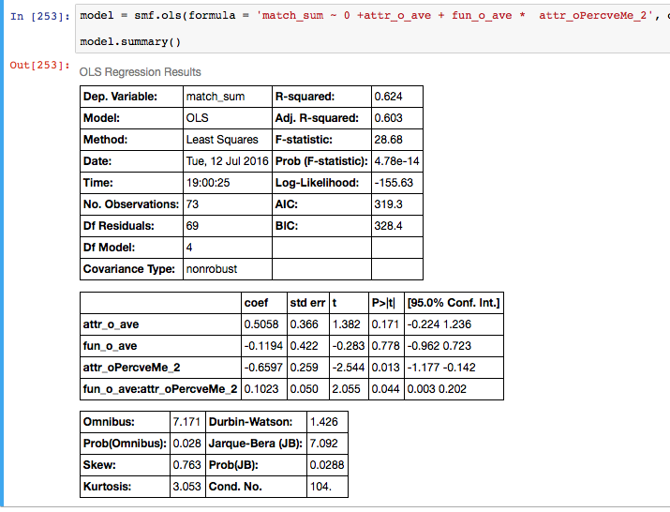
MODELS predicting match_sum
Notes:
Forcing intercept to 0

Slide 26
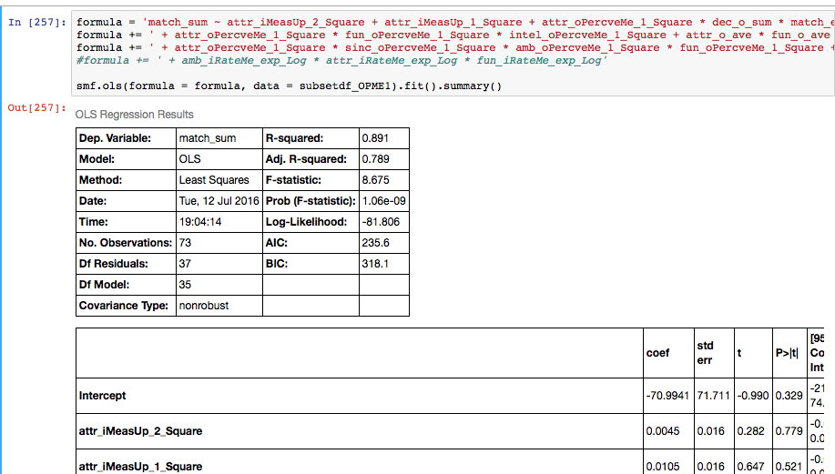
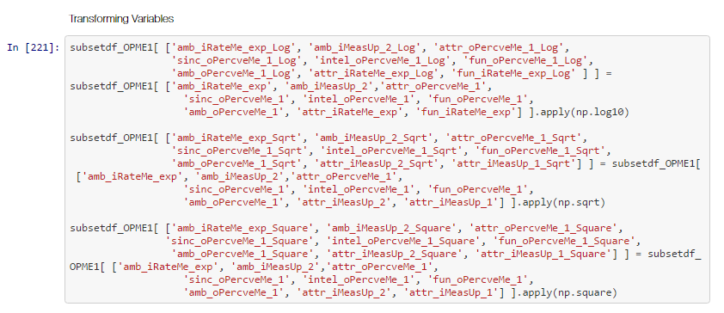
MODELS transformations

Slide 27
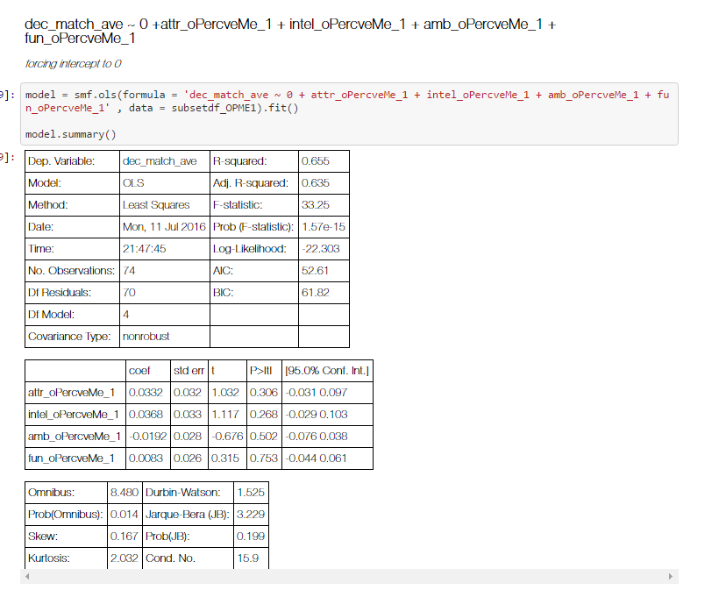
MODELS returned better when predicting dec_match_ave
Notes:
Would like to look more into dec_match_ave

Slide 28
FURTHER RESEARCH & EXPLORATION
Look at gender perceptions; how does that predict dating outcomes
Does one’s perception of their gender generalizations differ from their own evaluations of what’s important when it comes to selecting mates?
E.g.: do men rate ‘attractiveness’ as less important for their own dating choices but more important for other men?*
men will rate ‘attractiveness’ as less important for their own dating choices but more important for other men’s decisions when choosing a partner
Look at probability rating and score; i.e. if person gave high score but thought the prob of other person choosing them was low, how that affects decision (y/n); ultimately predicting match

Slide 29
ACKNOWLEDGMENTS
Kaggle
Ivan Corneillet
Bob Stark
Tim Payne
Classmates
Google

